Slide 1
Using MYSQL

Slide 2
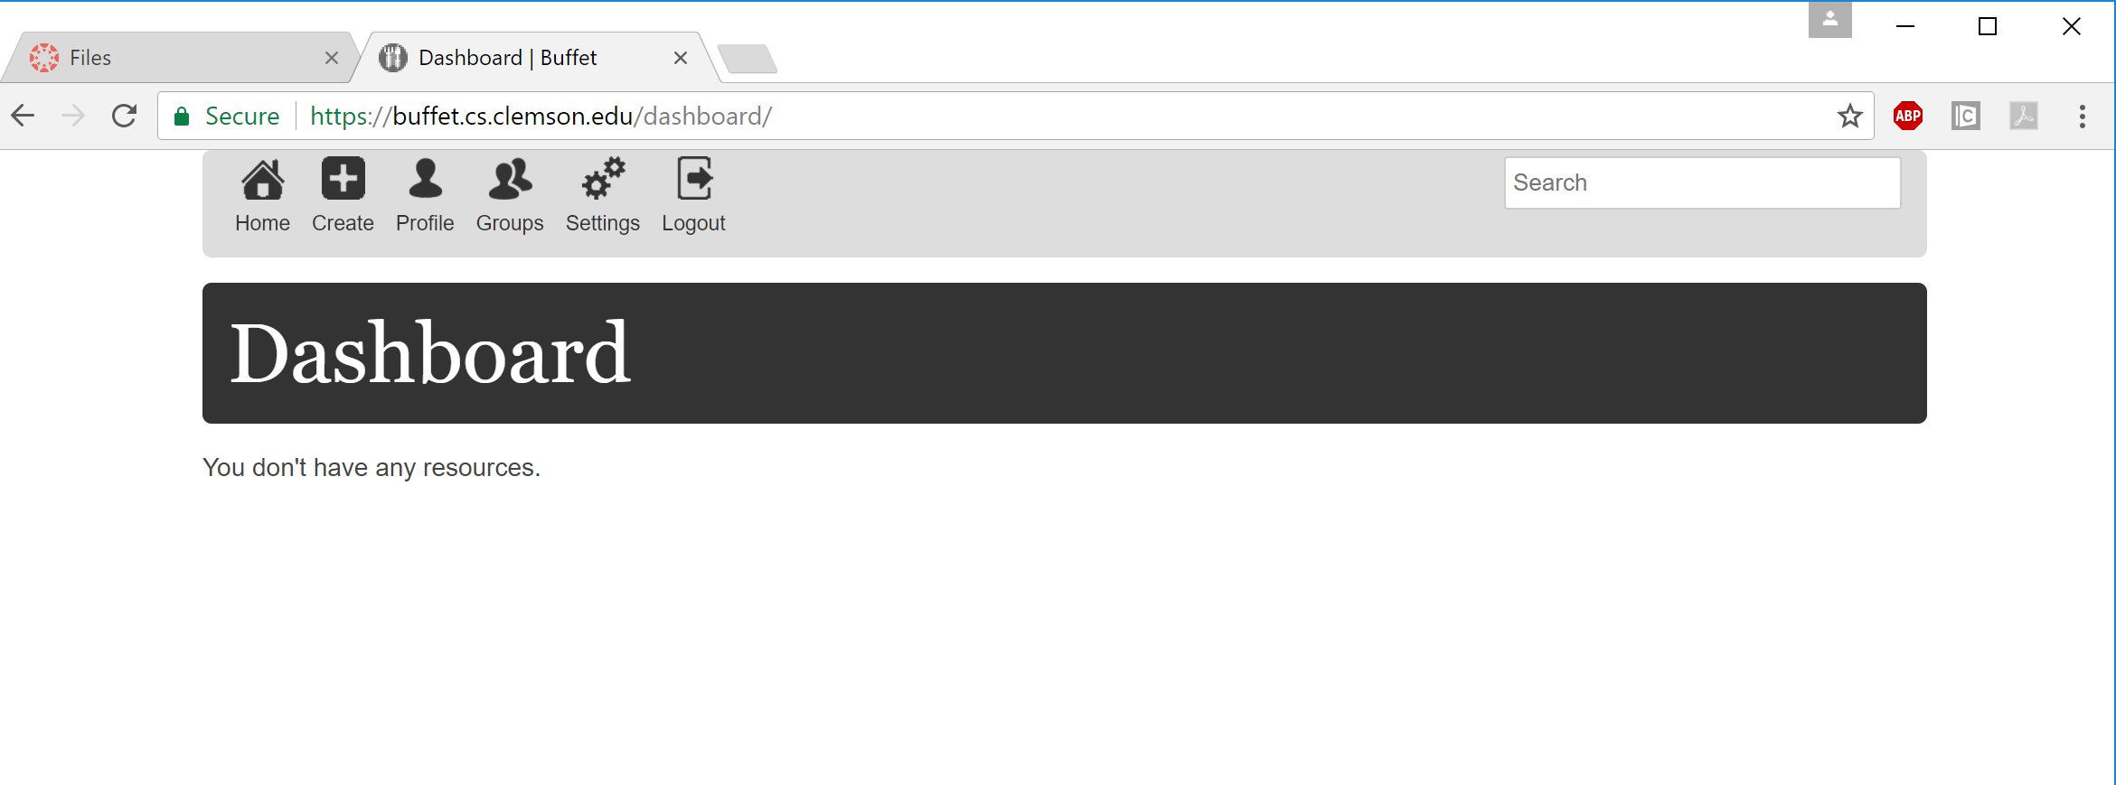
Visit set up web site
Visit buffet.cs.Clemson.edu through your browser
Login with your Clemson account

Slide 3
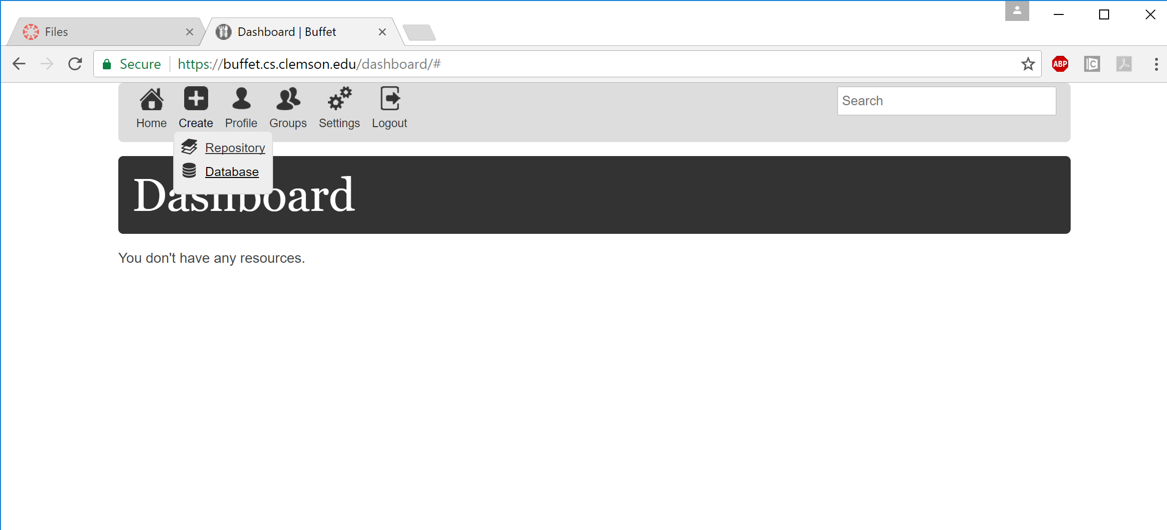
Create your database
Go to create and select “database”

Slide 4
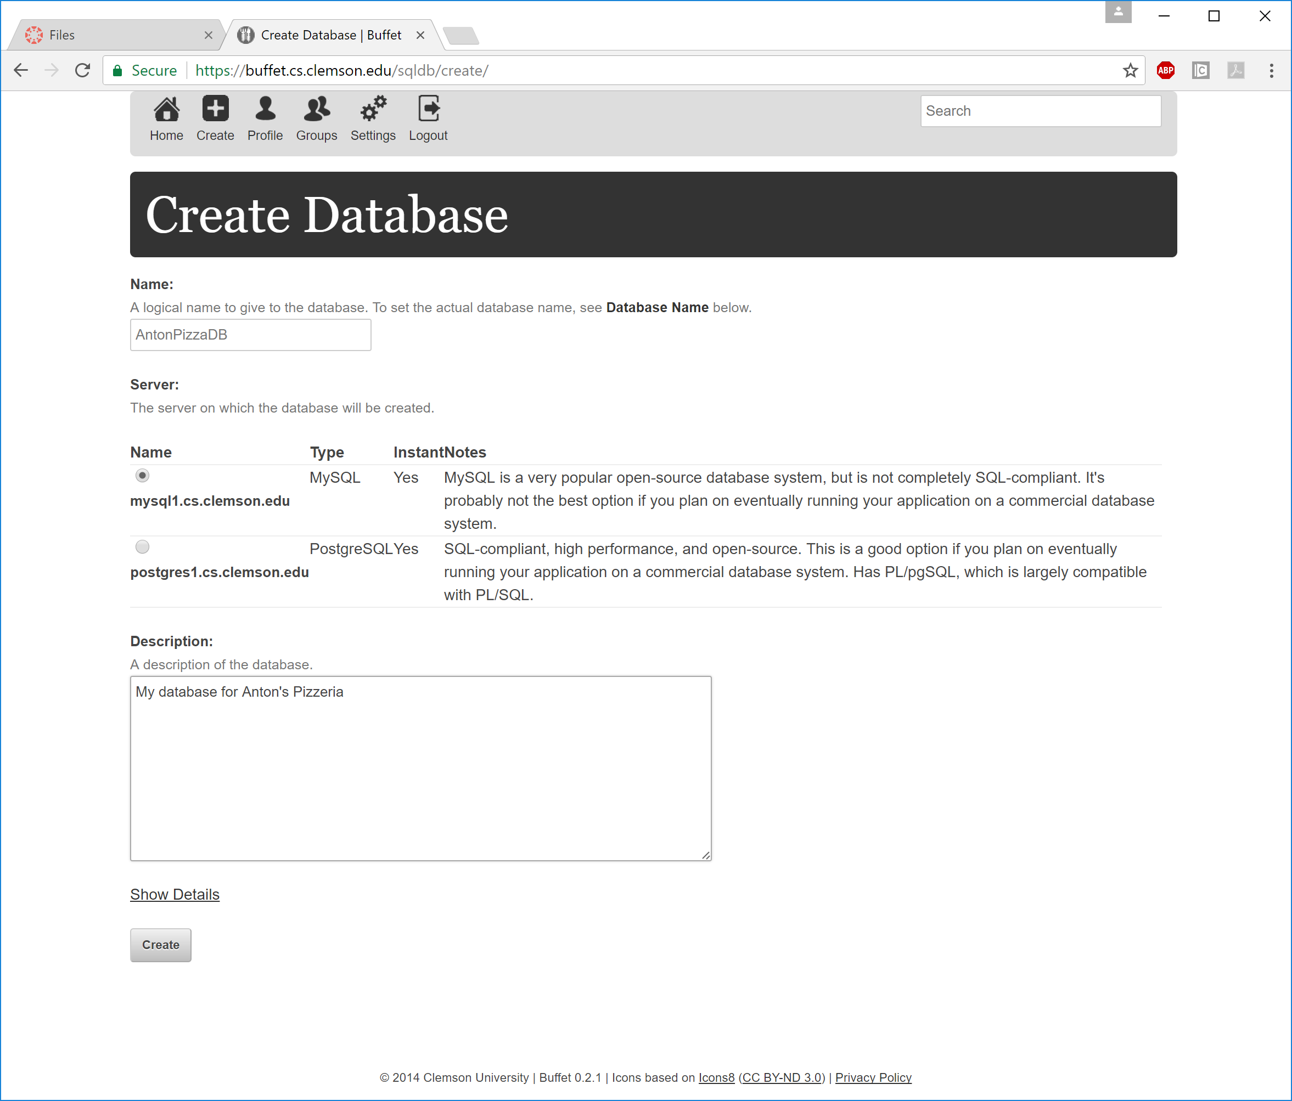
Name your database
No spaces
I will see this name
Select MySQL
Add a description if you want

Slide 5
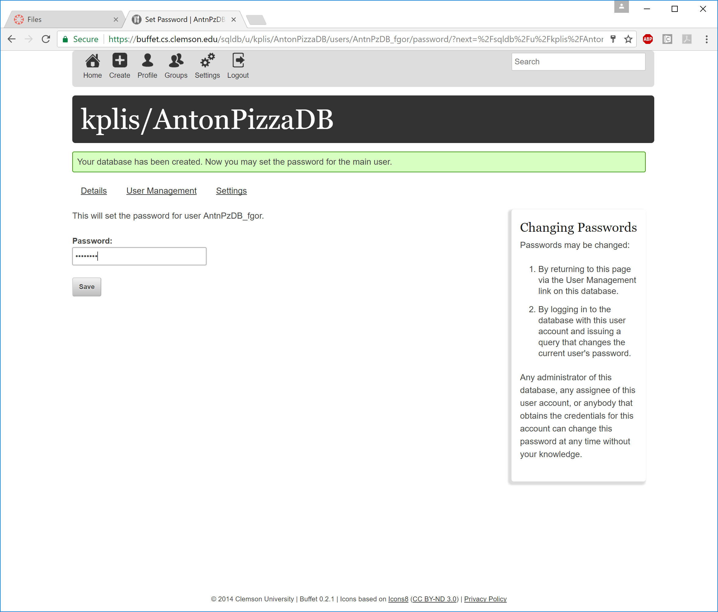
Create a password
You will need to give me the password so I can run your program
Use a password unrelated to any normal password you would use
Probably shouldn’t be I_Hate_Kevin either, since you will have to provide me with this password for grading

Slide 6
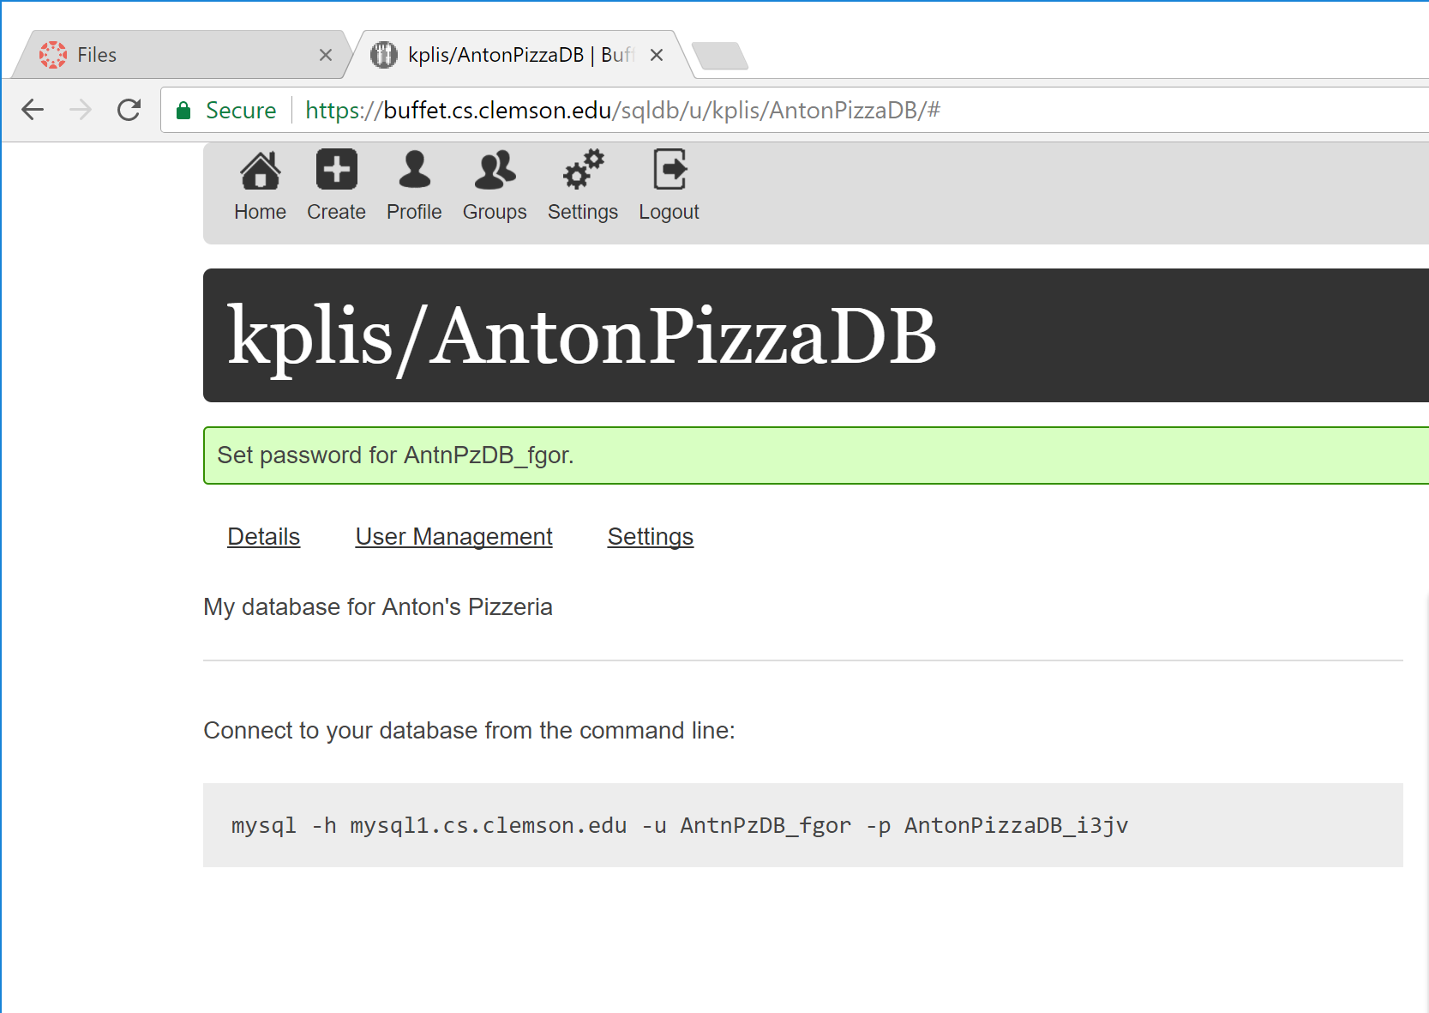
Save the connection string it provides you, you will need it

Slide 7
Connect through unix
Log into one of Clemson’s unix machines
Create a folder for CPSC4620
From that folder, enter the connection string you were provided
It will prompt for your password
When you are given access, you will now have a mysql prompt
Through the mysql prompt, you can enter SQL commands

Slide 8
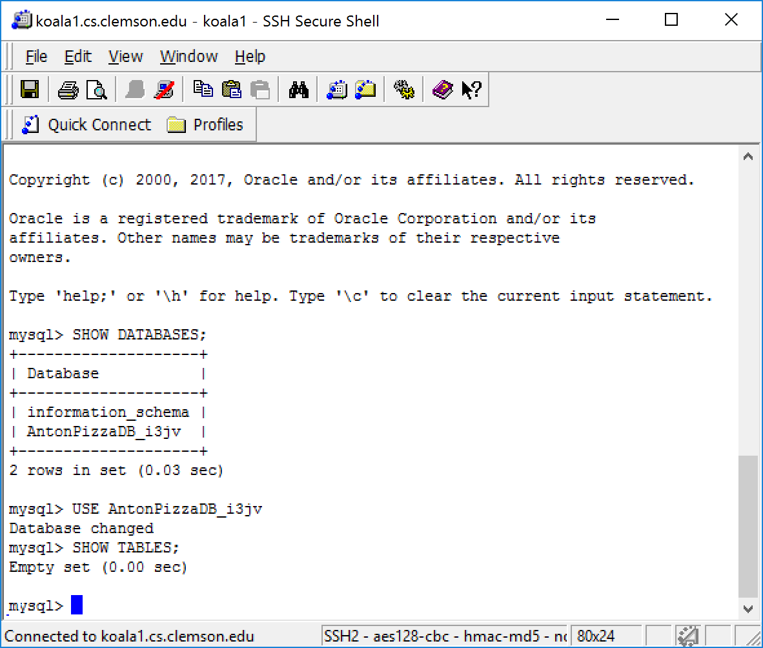
Using MySQL
SHOW DATABASES;
Will show a list of databases you have
USE <DB>;
Change to your database for this class
Now you can create tables and insert data

Slide 9
Helpful MySQL commands
SHOW TABLES;
Lists the tables in the database
DESCRIBE <Table>;
Gives the table schema
SOURCE <filepath>;
Run the SQL command stored in the file
EXIT;

Slide 10
Using a file to create your Database
Create a basic text file with your SQL commands
Remember, semi-colons end a command, not a line break
Use the source command to run the file
If it rejects a command, drop your tables, fix the error in the file and re-run it
If you don’t drop, and successful commands will run again and cause issues
Otherwise you have to type out the command in the mysql terminal, if it’s wrong you have to retype it
Have a file to create your tables, and a file to insert your values.
If you have an error partway through your insert statements, just use the DELETE sql command to clear your tables without removing the actual table
Keep your SQL code files in your 4620 folder, and always go to your 4620 folder before you connect to mysql so you don’t have to type out the full file path.

